Slide 1
COMP90054 AI Planning for Autonomy
Workshop Week5

Slide 2
Objectives
Delete Relaxation
Relationship between h*, h⁺, h^{add}, h^{max}, h^{FF}
How to compute h^{add}
How to compute h^{max}

Slide 3

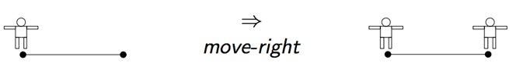

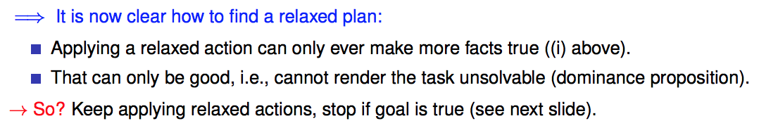
Delete Relaxation
Greedy Relaxed Planning

Slide 4
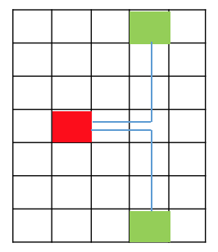
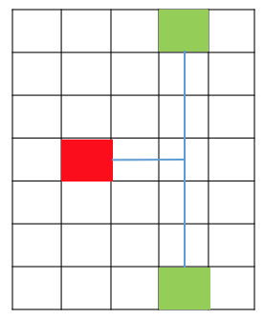
How would delete relaxation be interpreted in Pacman?
If computed with respect to each food it’s roughly a Minimum Spanning Tree (technically a Steiner Tree, since paths can branch in non-food location, i.e. the Steiner Points)
Minimum Spanning Tree
Steiner Tree

Slide 5

Relationship between h*, h⁺, h^{add}, h^{max}, h^{FF}
h*
h^{add} or h^{max}
estimate
approximate
h
(h⁺)
Extract a relaxed plan
To compute h^{FF}
approximate
h^{FF}
h⁺: is the optimal delete relaxation heuristic
But h+ is hard to compute

Slide 6
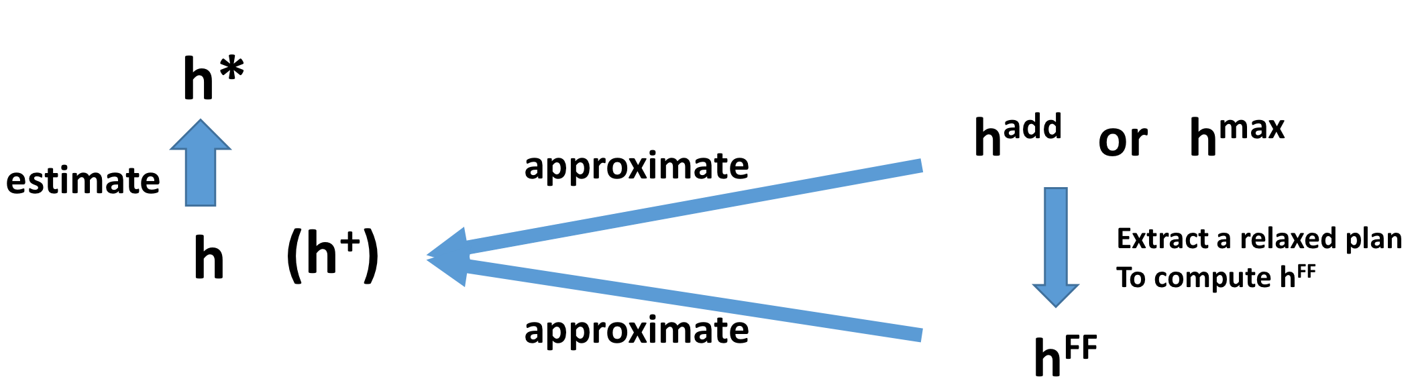
h⁺ is the optimal delete relaxation heuristic
h⁺ is admissible, so h⁺ <= h*
h^{max} is admissible h^{max} <= h*
but far too optimistic. h^{max} is too small. h^{max} <=h⁺
To sum up, h^{max} <= h⁺ <= h*
h^{add} is not admissible(so h^{add} can be larger than h* in some cases)
It is pessimistic. h^{add} overcounts. h^{add} >= h⁺
The properties of h^{FF} is similar with h^{add}, but h^{FF} won’t overcount

Slide 7
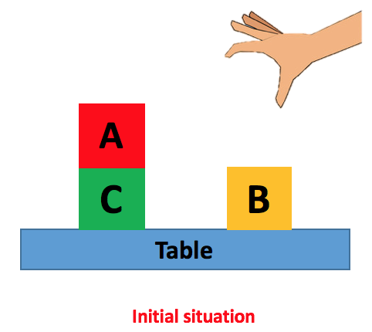
Domain Independent heuristic
Not specific to one problem.
e.g. delete relaxation, goal-counting
Manhattan distance

Slide 8
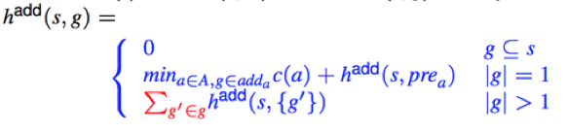
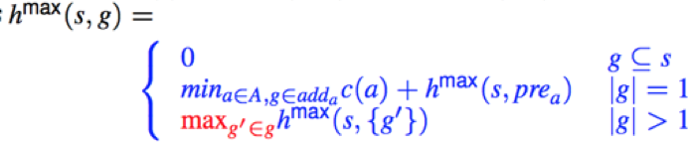
Bellman-Ford Algorithm
How to compute h^{add}
Recursive
Assumption: each goal can be achieved independently
How to compute h^{max}

Slide 9
Bellman-Ford Algorithm
How to compute h^{add}
Recursive
Assumption: each goal can be achieved independently
How to compute h^{max}

Slide 10
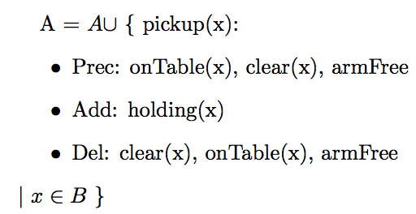
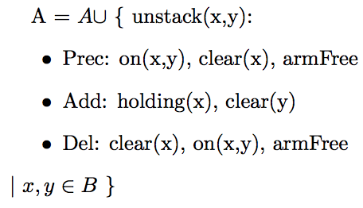
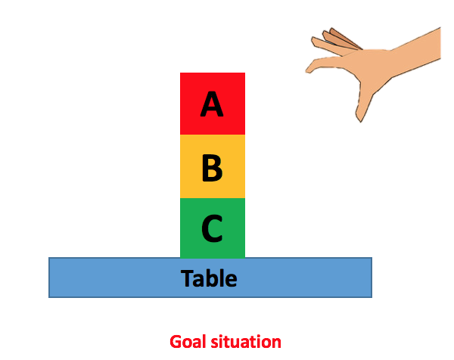
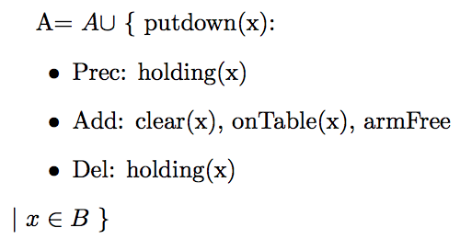
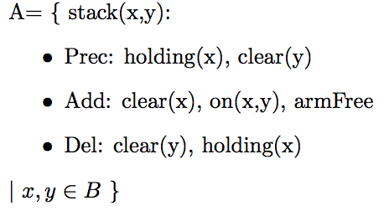
A blocks-world problem – 4 actions
Assume the cost of each action is 1

Slide 11







How to compute h^{add}
 | Cl(A) | Cl(B) | Cl(C) | onT(A) | onT(B) | onT(C) | On(A,B) | On(A,C) | On(B,C) | H(A) | H(B) | H(C) | ArmFree
0
1
2
3
0
0
$$∞$$
$$∞$$
0
0
$$∞$$
0
$$∞$$
$$∞$$
$$∞$$
$$∞$$
0
Initial Situation :
I = {on(A,C), onTable(C), onTable(B), clear(A), clear(B), armFree}
Cl(A)means Clear(A)
onT(A) means onTable(A)
H(A) means holding(A)

Slide 12
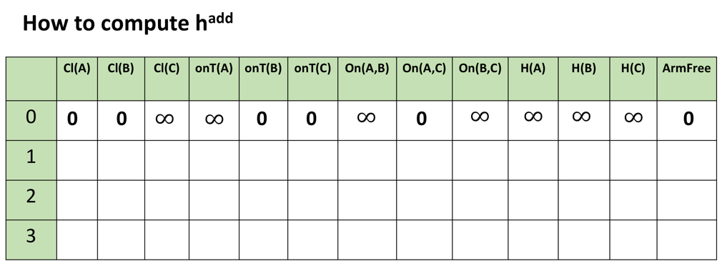
0
0
0
0
0
0

Slide 13
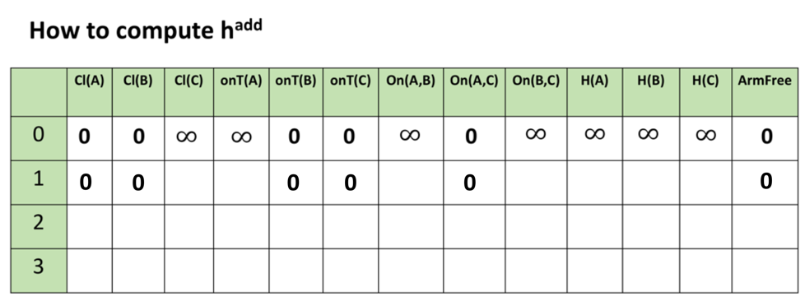
What (one) action can make clear(C) True?

Slide 14
A blocks-world problem – 4 actions

Slide 15
1
What (one) action can make clear(C) True?
unstack(A,C), unstack(B,C), putdown(C), stack(C,A), stack(C,B)

Slide 16
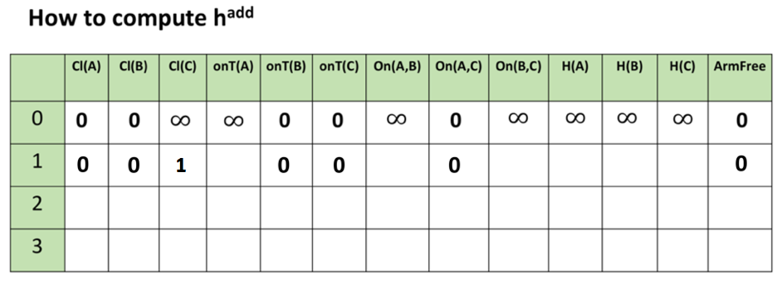



$$∞$$
What (one) action can make onTable(A) True?
Preconditions:
holding(A)
putdown(A)
$$∞$$
1
+
$$∞$$
=

Slide 17
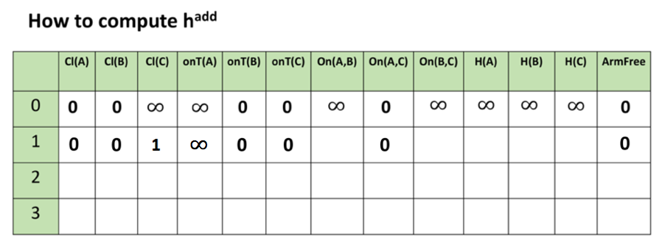



$$∞$$
$$∞$$
1
1
$$∞$$

Slide 18
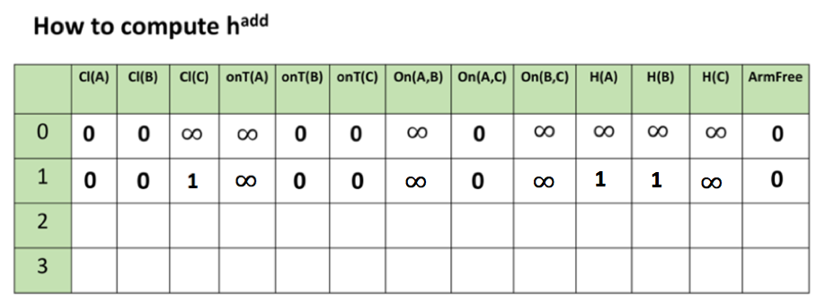

0
0
1
2
0
0
0
1
1
0
What (one) action can make onTable(A) True?
Preconditions:
holding(A)
putdown(A)
=
2
1
+
$$1$$

Slide 19
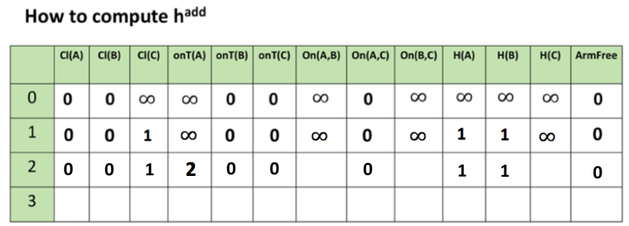
2
3(2)
2
add(max)
What (one) action can make on(B,C) True?
Preconditions:
holding(B)
clear(C)
1
stack(B,C)
h^{add} = 3
h^{max}=2
1
1

Slide 20
add(max)
2
3(2)
2
After we have get all the values in iteration 2. We shouldn't stop.
When to stop?
Converge
When the values of last two iteration are exactly the same

Slide 21
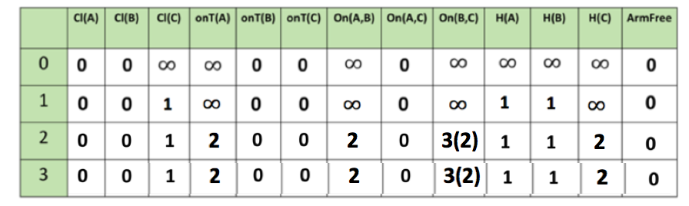
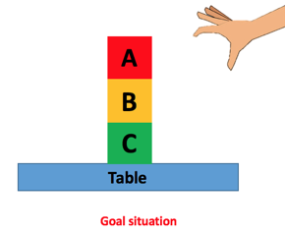
Last Step: Get h^{add} or h^{max}
add(max)
|G| = 4
> 1
h^{add} (I) = sum(0, 2, 3, 0) = 5
approximate
h+
h^{max} (I) = max(0, 2, 2, 0)= 2

Slide 22
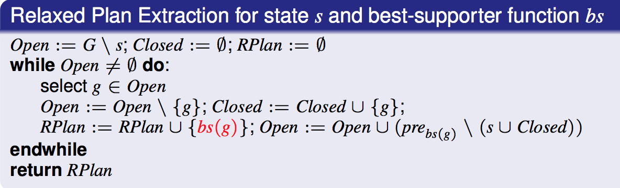
How to compute h^{FF}?
Extract a relaxed plan and then compute h^{FF}
How to extract a relaxed plan?
Step 1: Compute a best-supporter function
Best supporter function bs:
For every fact p ∈ F, an action that is deemed to be the cheapest achiever of p
(within the relaxation)
Step 2: Relaxed Plan Extraction

Slide 23
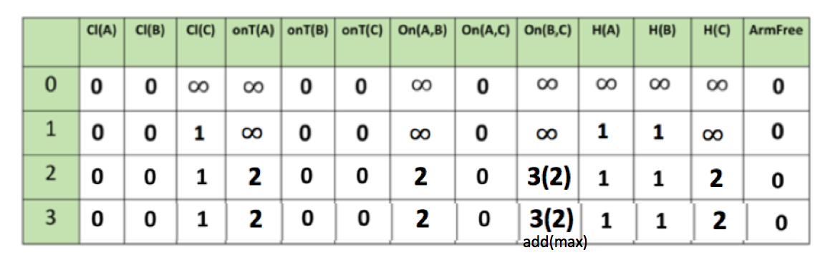
h^{add} or h^{max}
What (one) action can make Cl(C) True?
unstack(A,C), unstack(B,C), putdown(C), stack(C,A), stack(C,B)
Which action is the best supporter function of Cl(C) ?
Cheapest Achiever?

Slide 24
Which action is best supporter function for Cl(C)?
actions
preconditions
hadd
on(A,C)
Clear(A)
ArmFree
0
0
0
unstack(A,C)
1
+
= 1
on(B,C)
Clear(B)
ArmFree
+
3
0
0
= 4
unstack(B,C)
1
+
= 3
putdown(C) 1
holding(C) 2
+
holding(C) 2
Clear(A) 0
= 3
stack(C,A) 1
+
holding(C) 2
Clear(B) 0
= 3
stack(C,B) 1

Slide 25
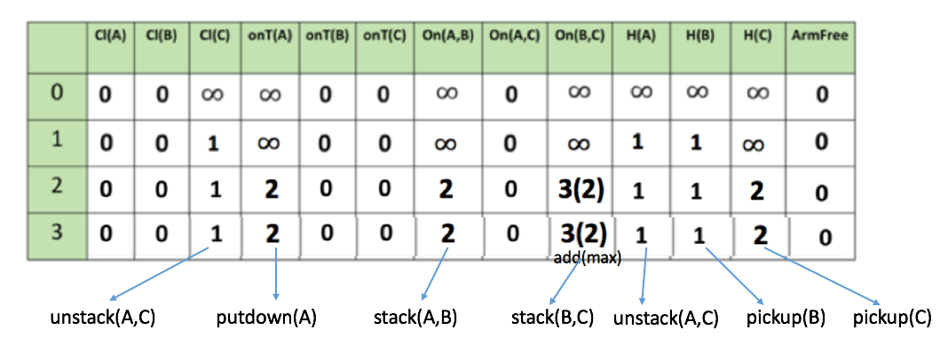
Best Supporter Function for each fact

Slide 26
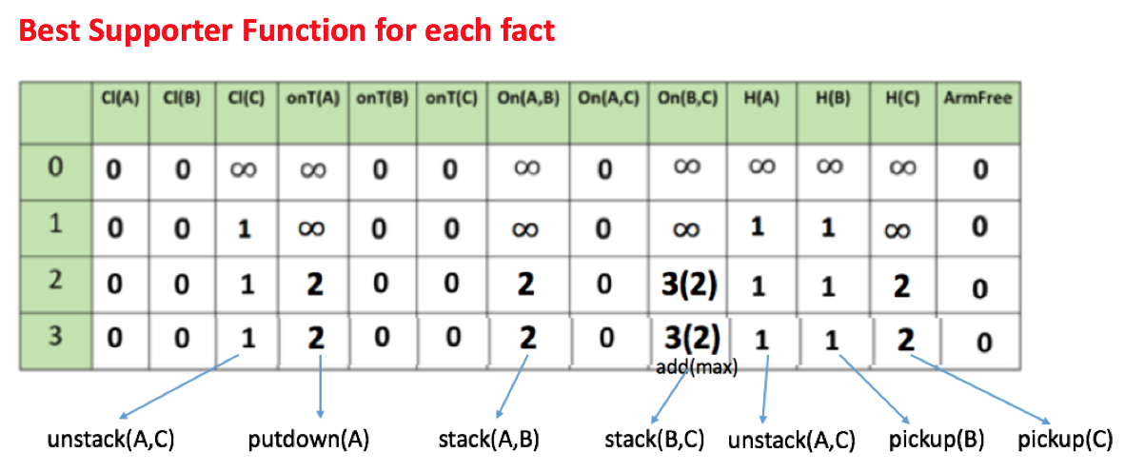


Extract Relaxed Plan
I = {on(A,C), onTable(C), onTable(B), clear(A), clear(B), ArmFree}
G = {on(A,B), on(B,C), onTable(C), clear(A), ArmFree}
Open := G \ I
Open = {on(A,B), on(B,C)}
Closed = $∅$
RPlan= $∅$

Slide 27





Extract Relaxed Plan
I = {on(A,C), onTable(C), onTable(B), clear(A), clear(B), ArmFree}
G = {on(A,B), on(B,C), onTable(C), clear(A), ArmFree}
U is set union operator, so there is no duplicate
Open = {on(A,B), on(B,C)}
Closed = $∅$
RPlan= $∅$
Precondition
bs(on(A,B)) = stack(A,B)
holding(A), clear(B)

Slide 28


Extract Relaxed Plan
I = {on(A,C), onTable(C), onTable(B), clear(A), clear(B), ArmFree}
G = {on(A,B), on(B,C), onTable(C), clear(A), ArmFree}
Open = {on(B,C), holding(A)}
Closed = {on(A,B)}
RPlan= {stack(A,B)}
Precondition
bs(on(B,C)) = stack(B,C)
holding(B), clear(C)

Slide 29


Extract Relaxed Plan
I = {on(A,C), onTable(C), onTable(B), clear(A), clear(B), ArmFree}
G = {on(A,B), on(B,C), onTable(C), clear(A), ArmFree}
Open = {holding(A), holding(B), clear(C)}
Closed = {on(A,B), on(B,C)}
RPlan= {stack(A,B), stack(B,C)}
Precondition
bs(holding(A)) = unstack(A,C)
on(A,C), clear(A), ArmFree
Notes:
All preconditons are already in the initial state, which means we don’t need to apply any action to achieve them.
We didn’t add anything new to openlist. But open list is still not empty.

Slide 30


Extract Relaxed Plan
I = {on(A,C), onTable(C), onTable(B), clear(A), clear(B), ArmFree}
G = {on(A,B), on(B,C), onTable(C), clear(A), ArmFree}
Open = {holding(B), clear(C)}
Closed = {on(A,B), on(B,C), holding(A)}
RPlan= {stack(A,B), stack(B,C), unstack(A,C)}
Precondition
bs(holding(B)) = pickup(B)
onTable(B), clear(B), ArmFree

Slide 31

Extract Relaxed Plan
I = {on(A,C), onTable(C), onTable(B), clear(A), clear(B), ArmFree}
G = {on(A,B), on(B,C), onTable(C), clear(A), ArmFree}
Open = {clear(C)}
Closed = {on(A,B), on(B,C), holding(A), holding(B)}
RPlan= {stack(A,B), stack(B,C), unstack(A,C), pickup(B)}
Precondition
Rplan = {stack(A,B), stack(B,C), unstack(A,C), pickup(B)}
bs(clear(C)) = unstack(A,C)
on(A,C), clear(A), ArmFree

Slide 32
Rplan = {stack(A,B), stack(B,C), unstack(A,C), pickup(B)}
How to get h^{FF} from Relaxed Plan?
Sum up the cost of actions in relaxed plan
h^{FF} = 4
for both hadd and hmax
Even hadd and hmax for some fact is different, but best supporter function for that fact are the same in this example.
So h^{FF} = 4 for both h^{add} and h^{max}

Slide 33
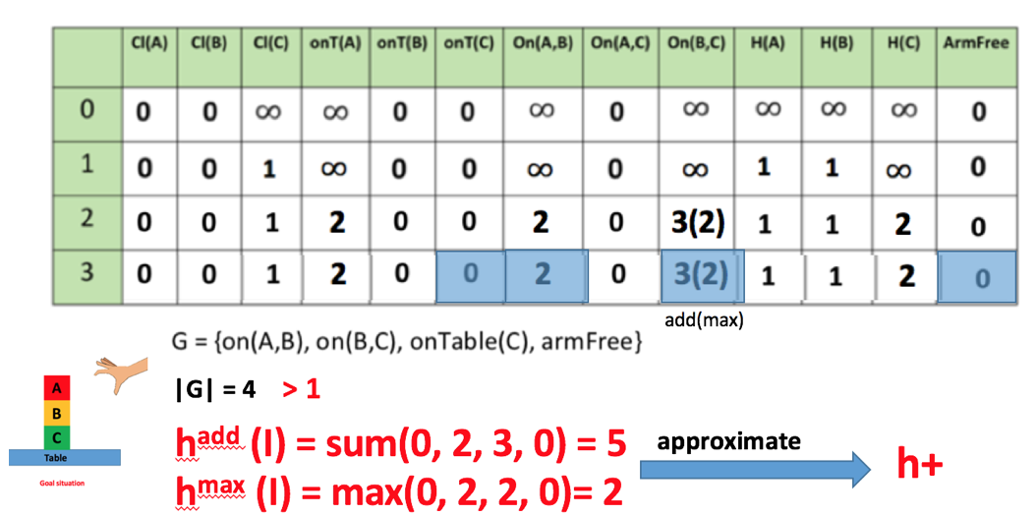
h^{FF} = 4
for both hadd and hmax

Slide 34
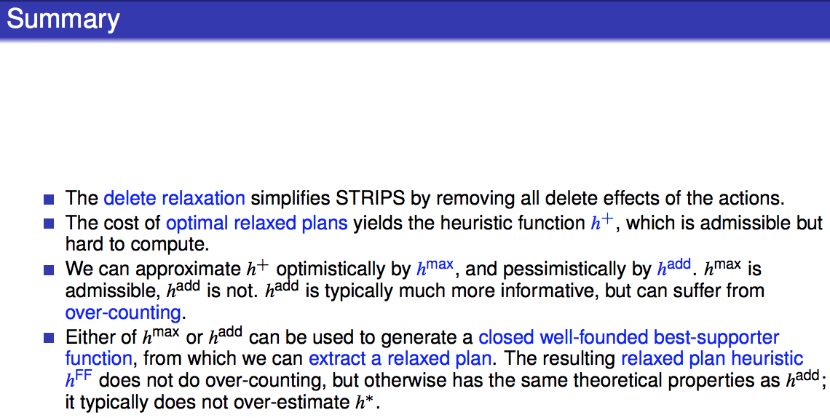

Slide 35
Relationship between h*, h⁺, h^{add}, h^{max}, h^{FF}
h⁺: is the optimal delete relaxation heuristic
But h+ is hard to compute

